Slide 1
Sustainability Assessment Tool
CASE STUDY
By Ankit Dhyani

Slide 2
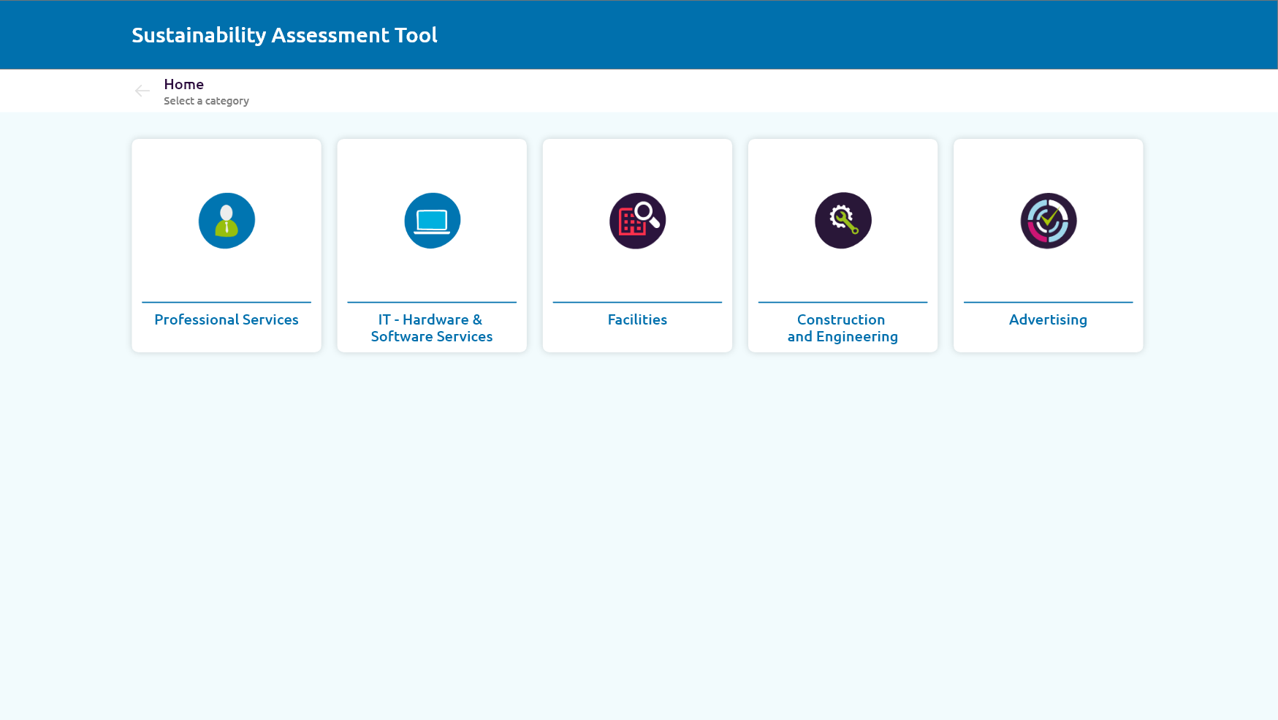
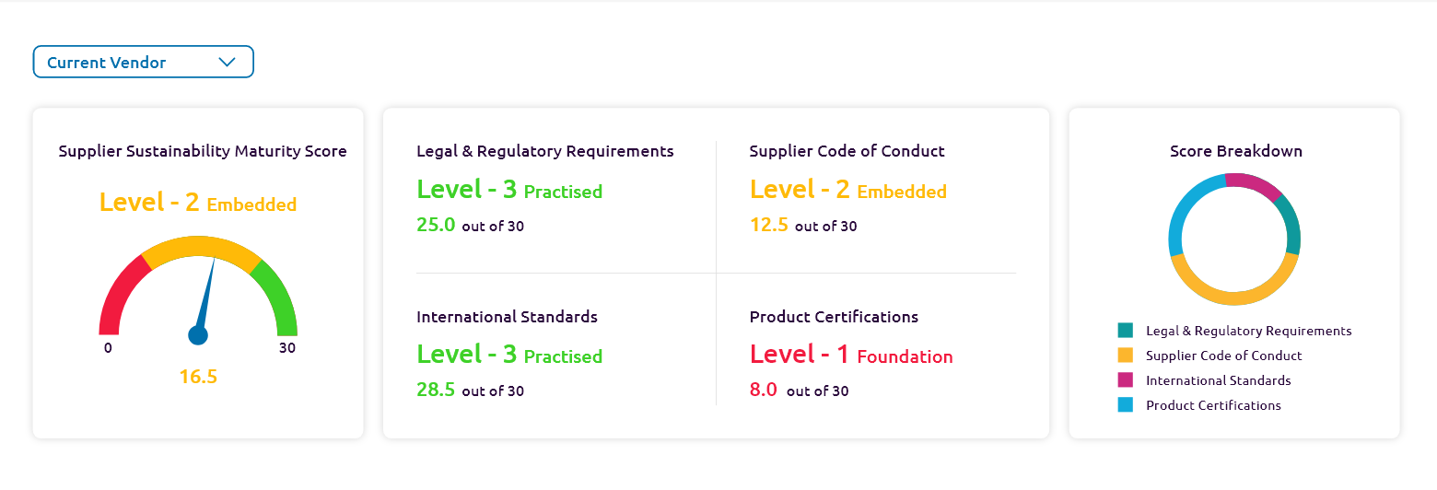
Sustainability Assessment Tool
Design Challenge
To create an application which can help in assessing its vendors and suppliers. Also, a dashboard view, that can help in analysing vendors’ performance in different categories.
About Application
Sustainability Assessment Tool will let its users to measure sustainability maturity index of vendors working or willing to work for them across various nations.

Slide 3
My Role
As a single designer for the project, I was responsible to create entire application from scratch by following the design process including gathering requirements, identifying the problem, ideating and designing.
List of Responsibilities
Understanding crux of application
Requirement gathering
Planning design delivery
Identify problems & goals
Design discussions with project managers
Creating user flows
Ideating designs
Presenting lo-fi wireframes
Final designs

Slide 4
The Goal
Create digital platform to assess both existing and new vendors.
A dashboard to monitor the scores and performance of vendor assessed.
A single place to edit the assessments (only for admin).
Browse 1000+ vendors all across the world registered with ERP.

Slide 5
Requirement Gathering
Connected with project managers of the team to understand more about the application’s stakeholders and what are the client’s requirements.
They also collaborated with me as a team and tried to provide me data on their vision as well.
Excel and Word templates were also shared for better understanding among all the teams.
Daily meetings for tracking the work progress and issues being faced.

Slide 6
Ideation Phase
Created user flows and validated with VP of the current organisation.
Based on the approved user flows, created lo-fi digital wireframes

Slide 7
Final Delivery
Made required iterations on the wireframes based on feedback.
High-fidelity design screens were presented to the whole team
Handed over the designs to the dev team.

Slide 8
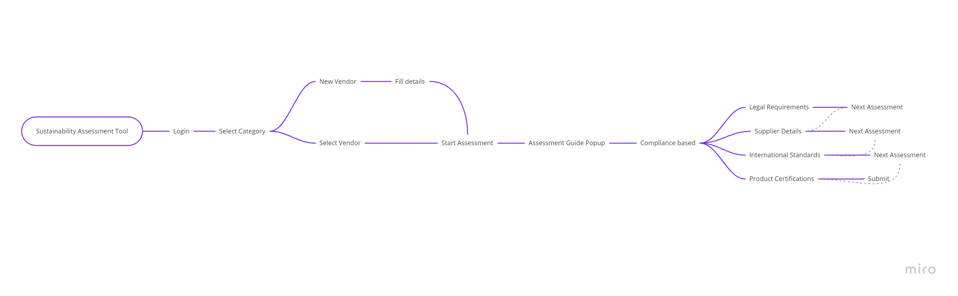
User flow

Slide 9
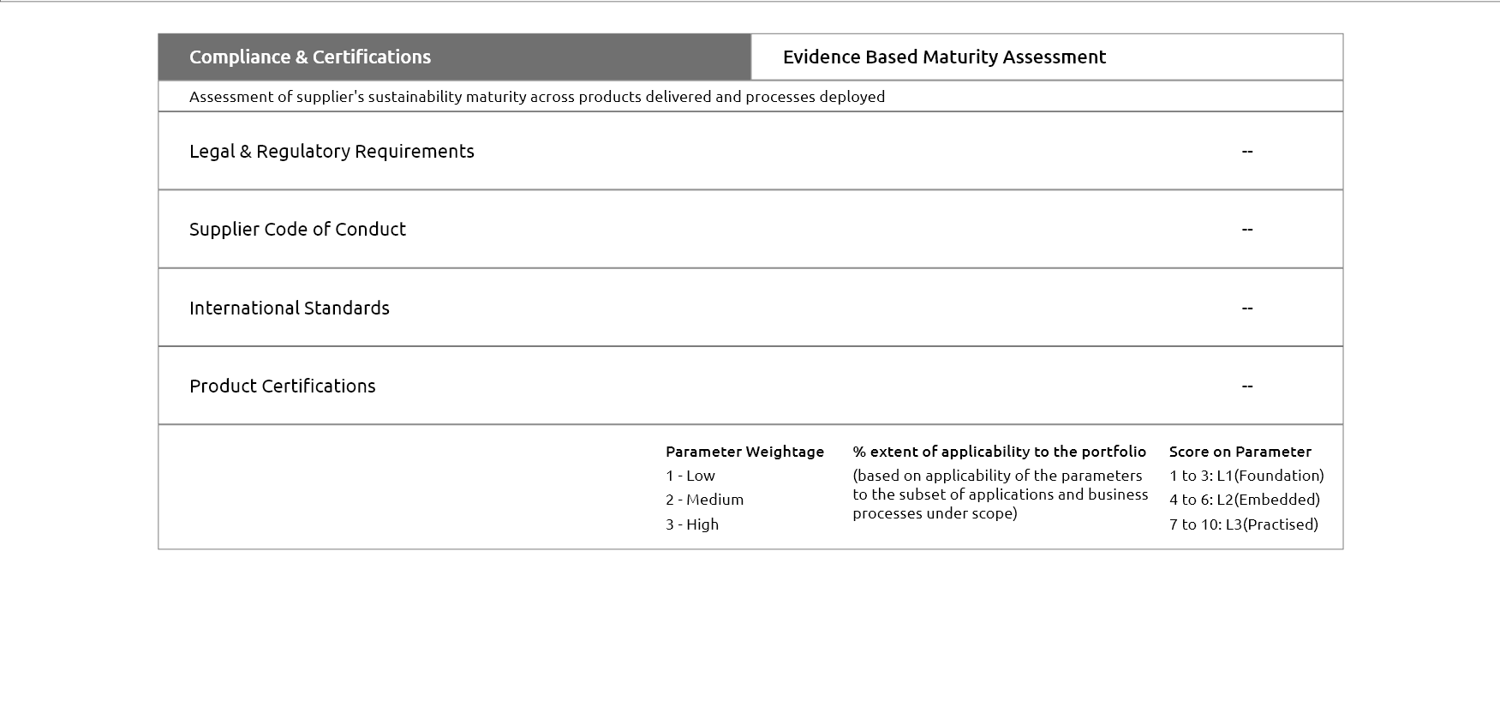
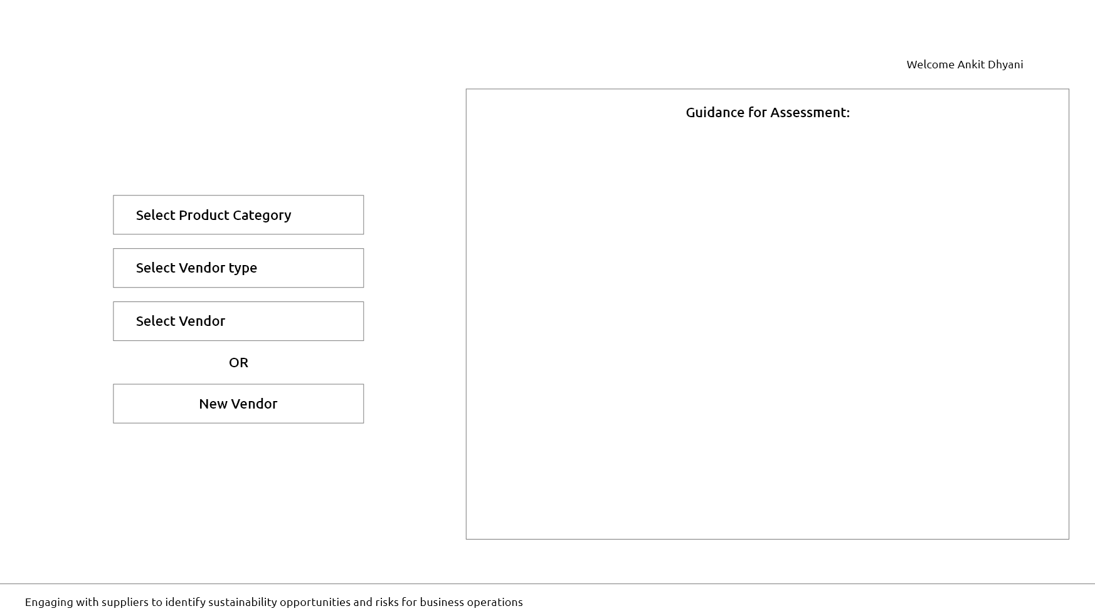
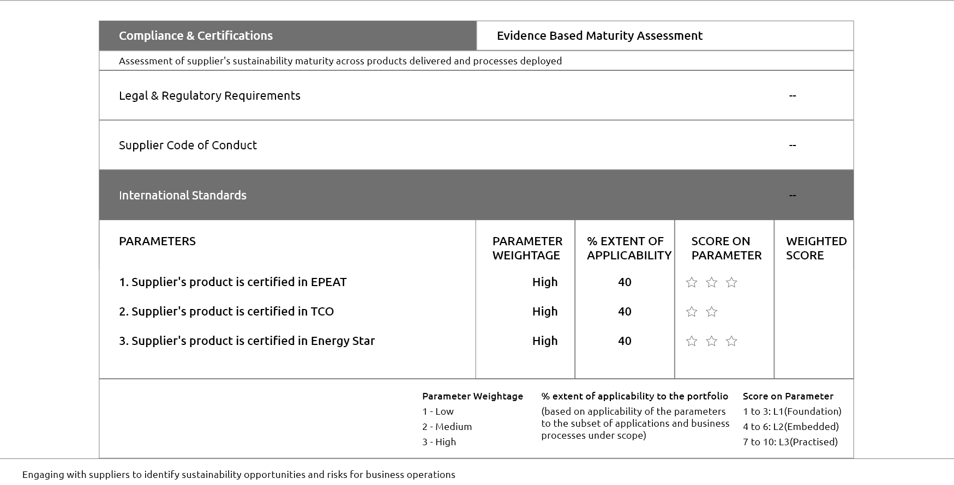
Wireframes

Slide 10

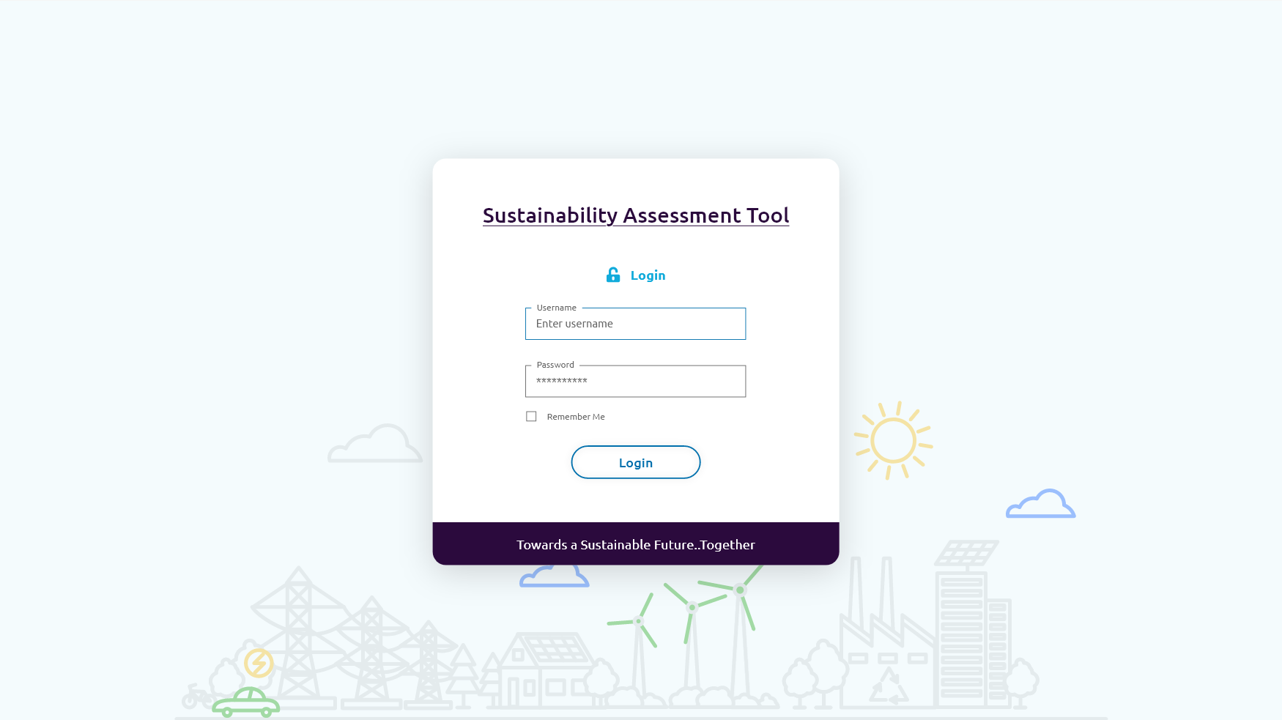
Some final designs

Slide 11
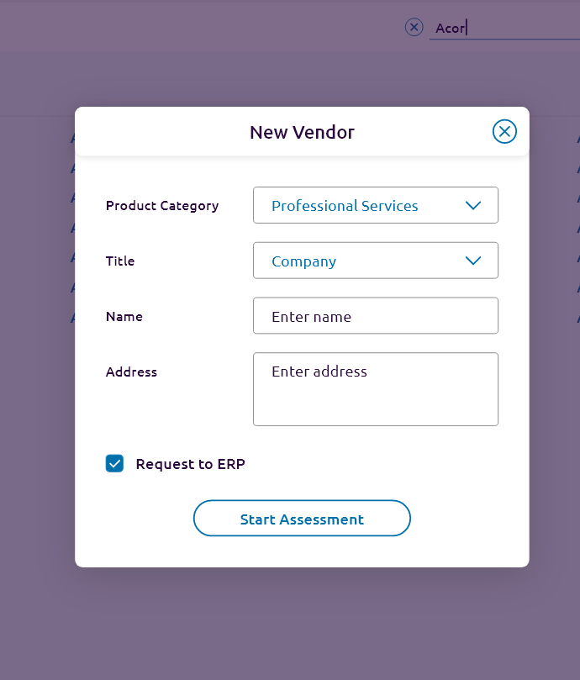
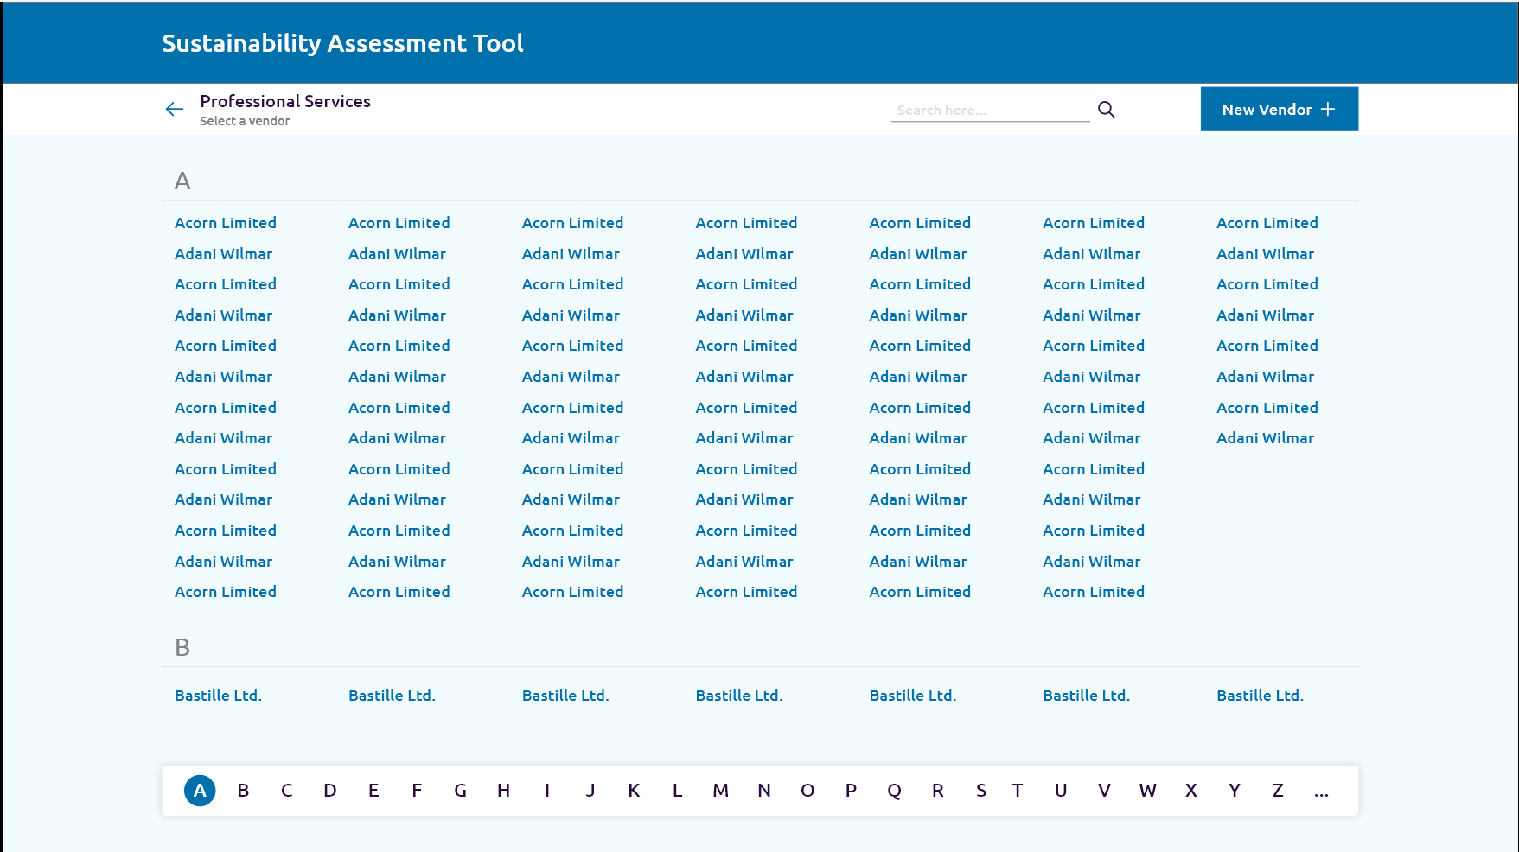
Some final designs

Slide 12
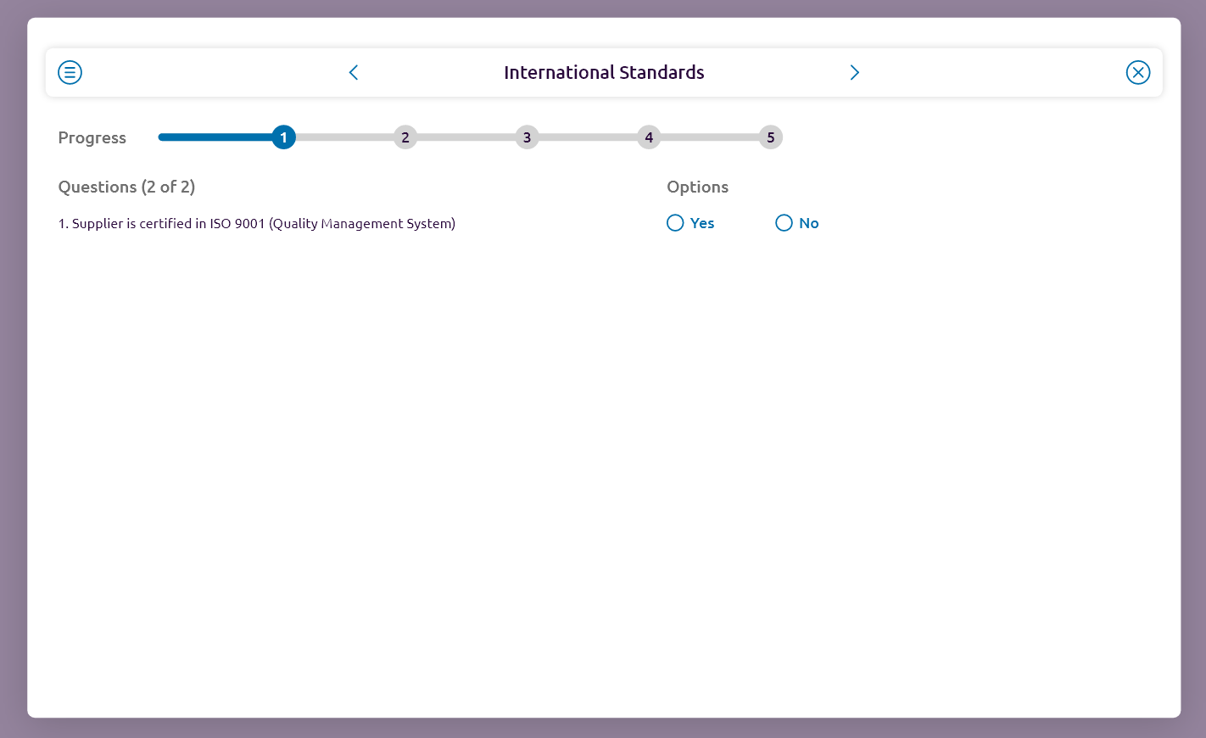
Some final designs

Slide 13
Thank you

